Slide 1
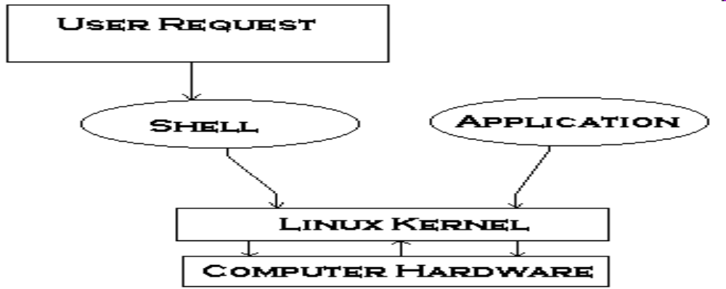
What is shell?
A shell is a program that takes commands typed by
the user and calls the operating system to run those
commands.
Shell accepts your instruction or commands in English and translates it into computer’s native binary language.`

Slide 2
Kind of Shells
Bourne Shell
C Shell
Korn Shell
Bash Shell
Tcsh Shell

Slide 3
Kind of Shells
1. The C Shell –
Denoted as csh.
It incorporated features such as aliases and command history.
It includes helpful programming features like built-in arithmetic and C-like expression syntax.
Command full-path name is /bin/csh

Slide 4
Kind of Shells
2. The Bourne Shell –
Denoted as sh
It was written by Steve Bourne at AT&T Bell Labs.
It is the original UNIX shell.
It lacks features for interactive use like the ability to recall previous commands. It also lacks built-in arithmetic and logical expression handling.
It is the default shell for Solaris OS.
Command full-path name is /bin/sh and /sbin/sh

Slide 5
Kind of Shells
3. The Korn Shell
It is denoted as ksh
It includes features like built-in arithmetic and C-like arrays, functions, and string-manipulation facilities.It is faster than C shell.
It is compatible with script written for C shell.
Command full-path name is /bin/ksh

Slide 6
Kind of Shells
4. GNU Bourne-Again Shell –
Denoted as bash
It is compatible to the Bourne shell. It includes features from Korn and Bourne shell.
Command full-path name is /bin/bash

Slide 7
Check Shell
To find all available shells in your system type the following command:
$ cat /etc/shells

Slide 8
Changing Your Default Shell
chsh –s <shell path>
COMMAND LINE ARGUMENTS

